Slide 1

GivaMe!
Evaluate Your Kiva Campaign
Chao Li
Insight 2019B

Slide 2
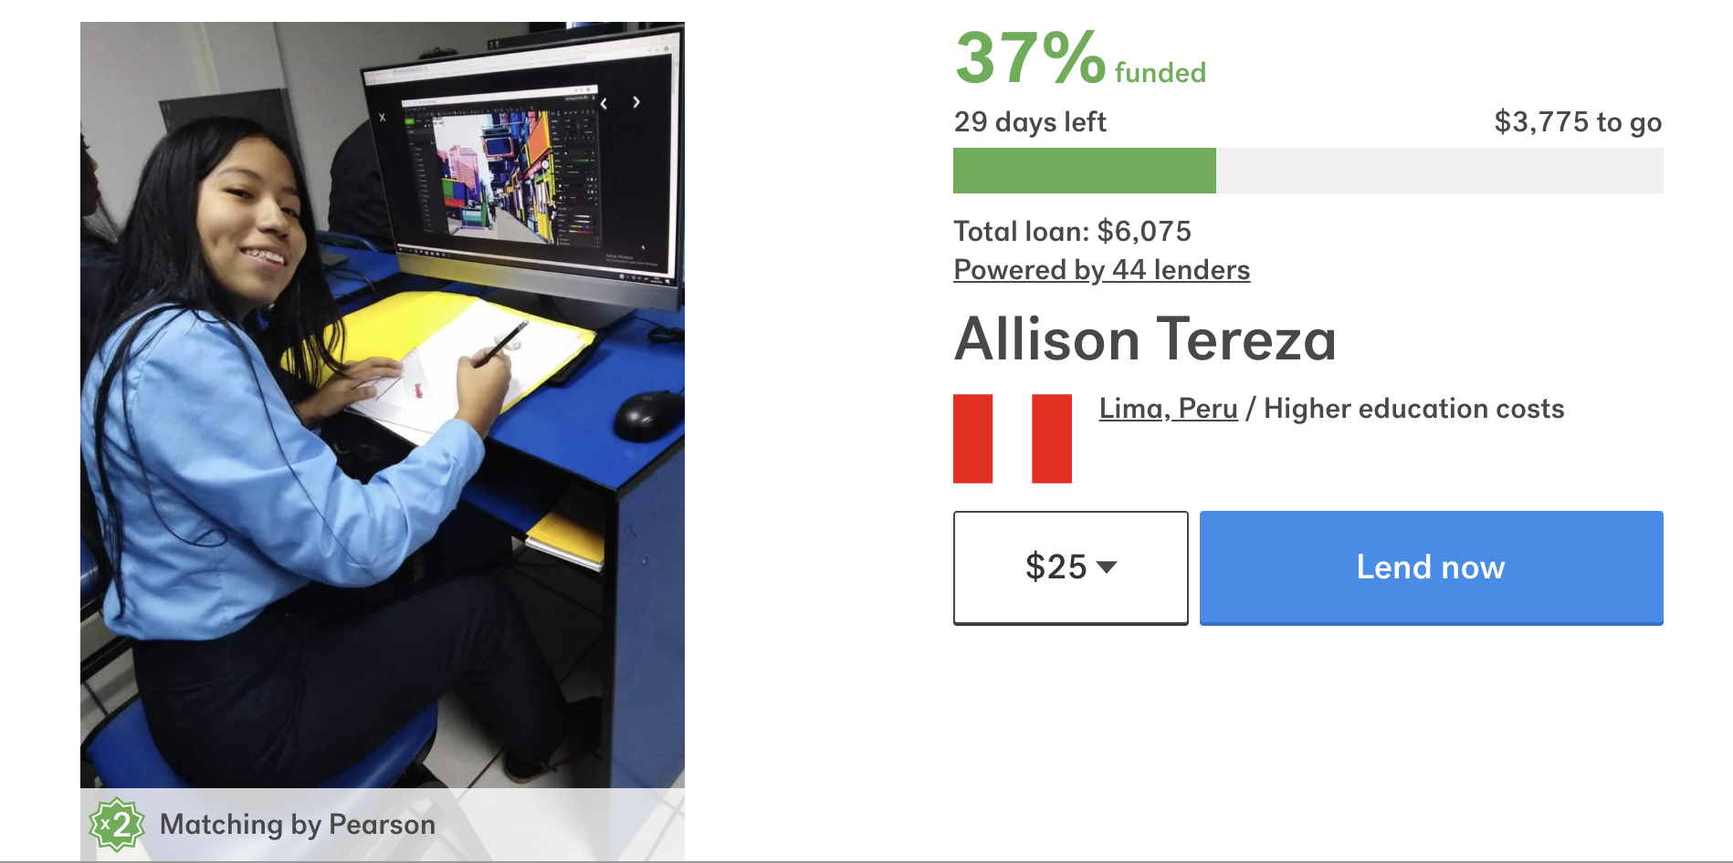

Kiva.org: world’s first micro-lending platform
2
Fundraising period:
30 days

Slide 3
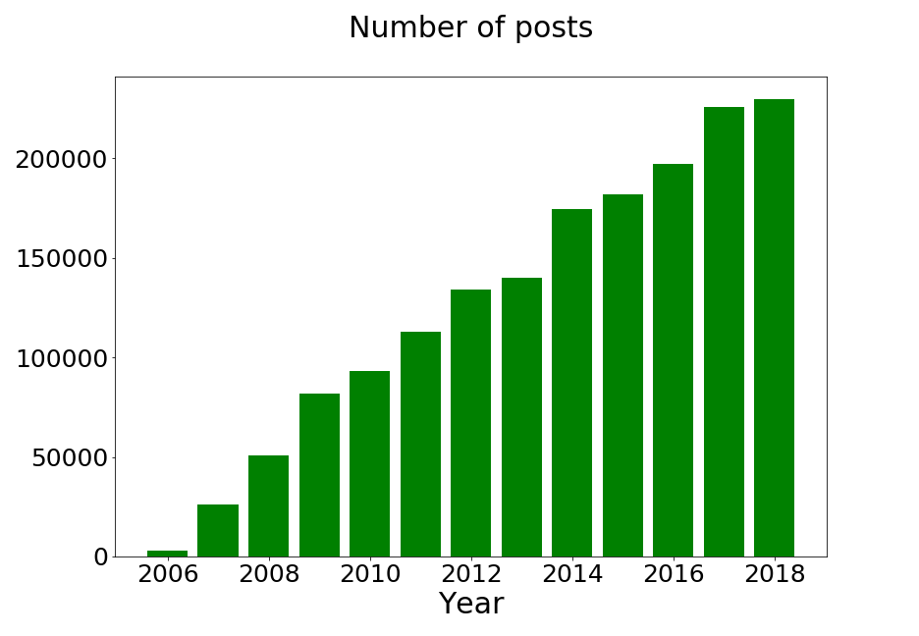
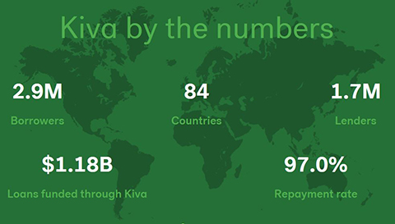
Needs: Number of non-funded Kiva loans are increasing!
3

Slide 4
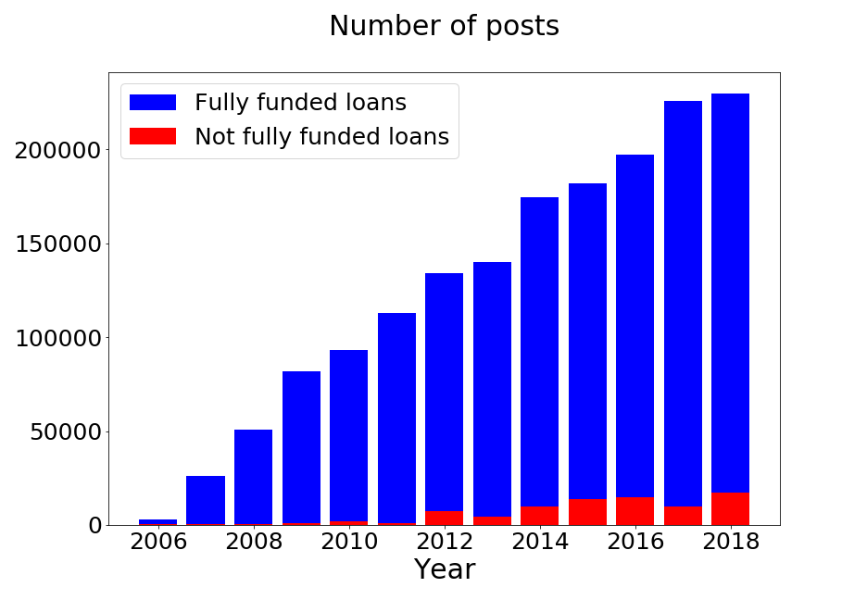
Needs: Number of non-funded Kiva loans are increasing!
4

Slide 5

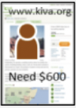




Proposed solution
5
Borrowers
Lenders
Field partners

Slide 6
Proposed solution
6
Borrowers
Web app
Lenders
GivaMe!
Field partners
Predicting the chance of a loan request being fully funded

Slide 7
Baseline model
7
Features from Kiva website:
Borrowers
Number of female
Number of male
Random Forest classifier
Field partners
Directly
With field partners
AUC score: 62%
~10 K posts in US
False positive rate: 37%
Loan details
Loan amount
Loan use
Loan term
Repayment method

Slide 8
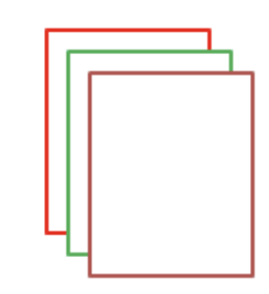
Topic modeling on personal stories
8
4
3
2
Topic modelling
1
(LDA)
Collection of personal stories
Topic 1: Business and work
Topic 2: Family
Topic 3: Personal life and hobbies
Topic 4: Education
……

Slide 9
Model and validation
9
Random forest classifier with features from topic modeling
Borrowers
Number of female
Number of male
Field partners
Directly
With field partners
Random Forest classifier
Loan amount
Loan use
Loan term
Repayment method
AUC score: 70%
Loan details
False positive rate: 34%
~10 K posts in US
Text mining
Topics
Number of tags

Slide 10
Demo
http://givamekiva.com/

Slide 11
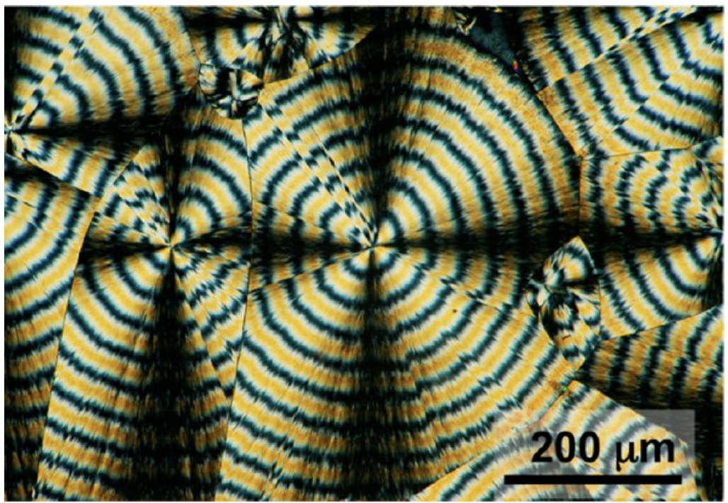

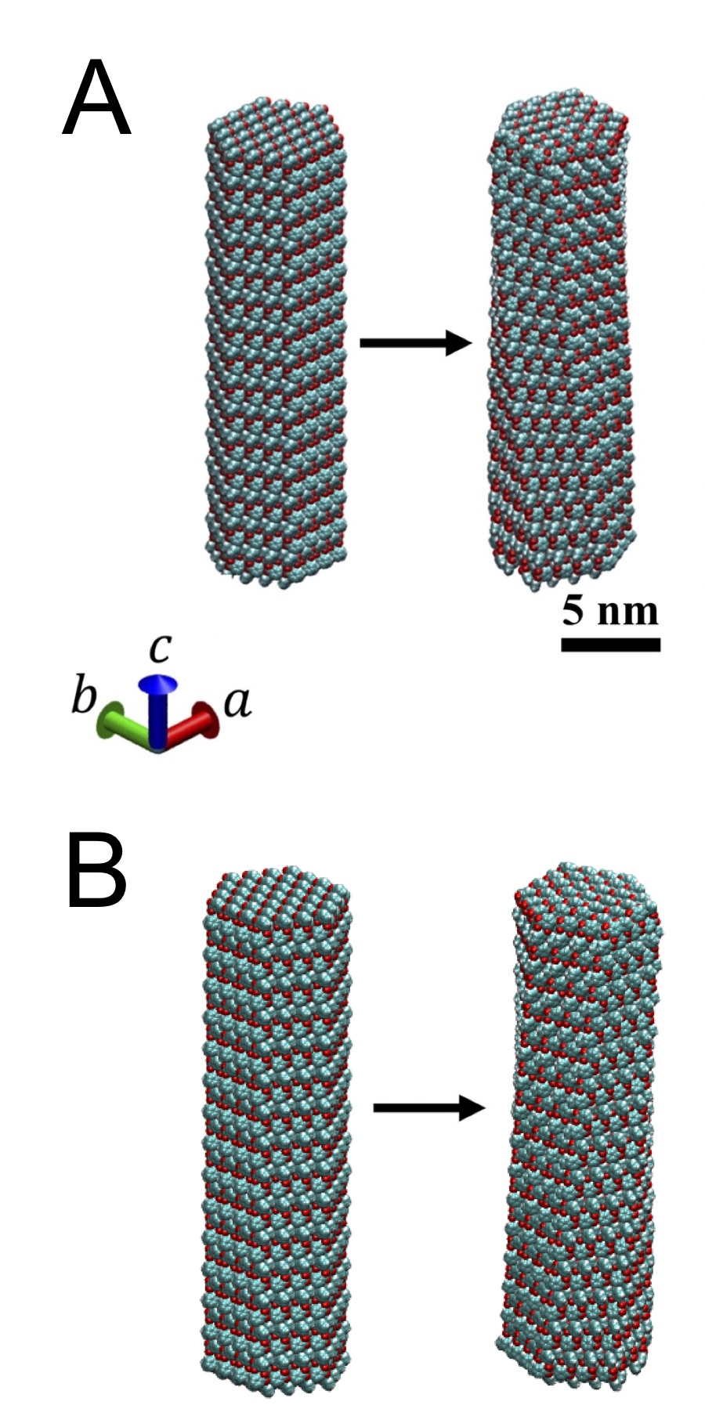
About Me
Chao Li

Slide 12
Baseline model
12
Features from Kiva website:
Borrowers
Country
Female/Male
Random forest classifier
Field partners
Partner risk rate
Total loans posted
Total amount raised
Default rate
~700 K posts
Loan details
Loan amount
Loan use
Loan term
Repayment method

Slide 13
Model and validation
13
Random forest classifier with features from topic modeling
Borrowers
Country
Female/Male
Field partners
Partner risk rate
Total loans posted
Total amount raised
Default rate
Random forest classifier
Loan details
Loan amount
Loan use
Loan term
Repayment method
~700 K posts
Text mining
Topics
Number of tags

Slide 14
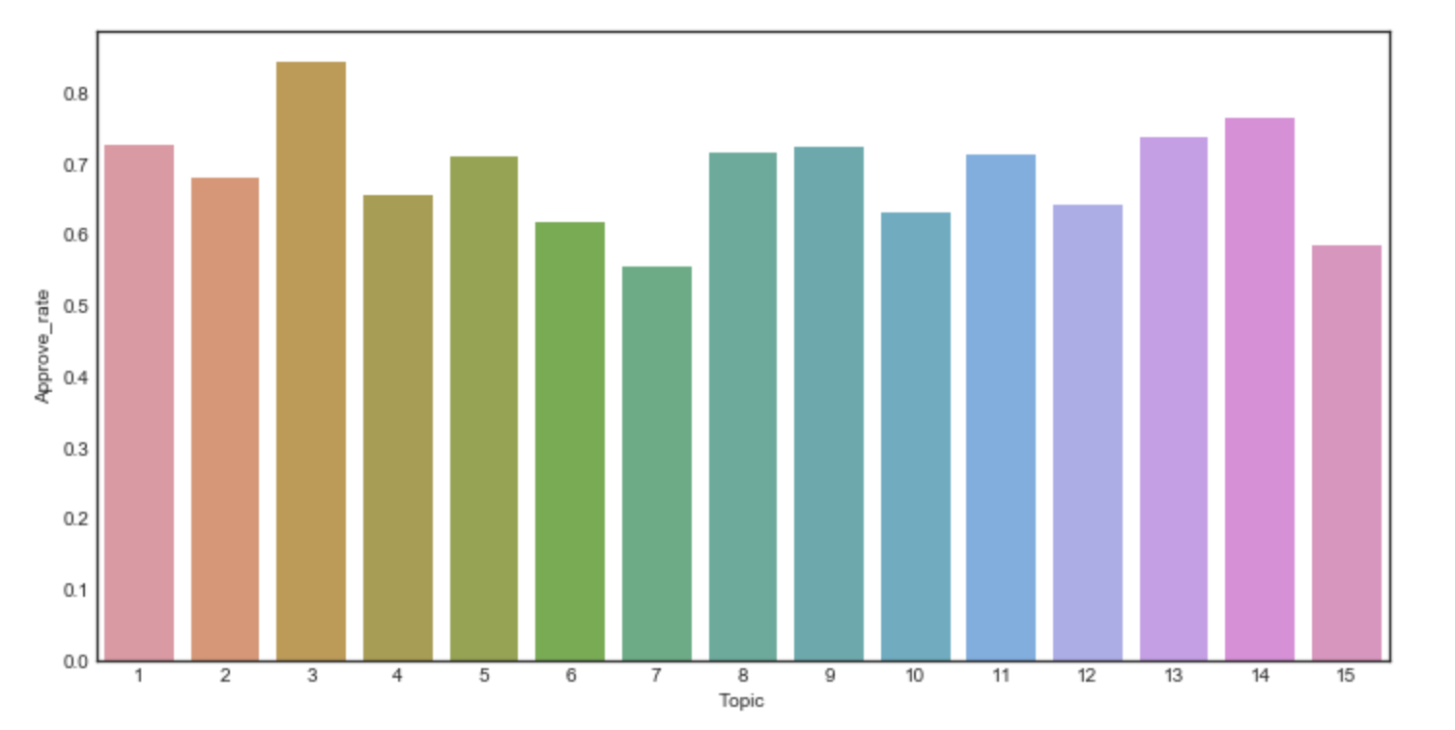
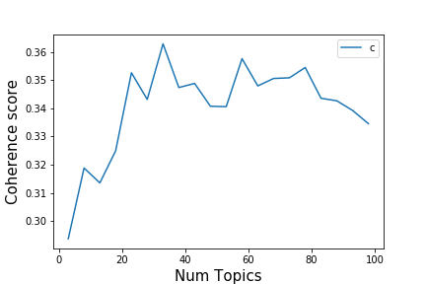
Topic modeling
Topics from personal stories
Latent Dirichlet Allocation
33 Topics
Topic 1: business, life, work, hard
Topic 2: people, community, world, city
Topic 3: loan, need, help, purchase
Topic 4: food, farm, kitchen, cooking
Topic 5: family, school, business, work
Topic 6: health, family, cancer, care
Topic 7: school, university, education, degree
Topic 8: support, start, new, future
Topic 9: company, job, work, opportunity
Topic 10: coffee, fashion, music, clothing

Slide 15
Baseline model
15
Features from Kiva website:
Borrowers
Country
Female/Male
Random forest classifier
Field partners
Partner risk rate
Total loans posted
Total amount raised
Default rate
AUC score: 62%
~700 K posts
Predicted
Expired
Funded
Loan details
Loan amount
Loan use
Loan term
Repayment method
482 | 284
649 | 1106
Expired
Actual
Funded

Slide 16
Model and validation
16
Random forest classifier with features from topic modeling
Borrowers
Country
Female/Male
Field partners
Partner risk rate
Total loans posted
Total amount raised
Default rate
Random forest classifier
AUC score: 70%
Loan details
Loan amount
Loan use
Loan term
Repayment method
~700 K posts
Predicted
Expired
Funded
504 | 262
483 | 1272
Expired
Text mining
Topics
Number of tags
Actual
Funded

Slide 17
Feature | Importance/%
Loan amount | 27.78
Num_tag | 26.56
Topic of personal story | 13.38
Loan use | 10.18
Repayment method | 8.73
Distribution model | 8.17
Number of female | 2.33
Number of male | 2.20

